Slide 1


DevOps Engineer
Graduation Project
1-Mohamed Helall
2-Ahmed Emad
3-Ebrahim Abdelmonem
4-Ahmed Bayomi
5-Ahmed Embaby

Slide 2
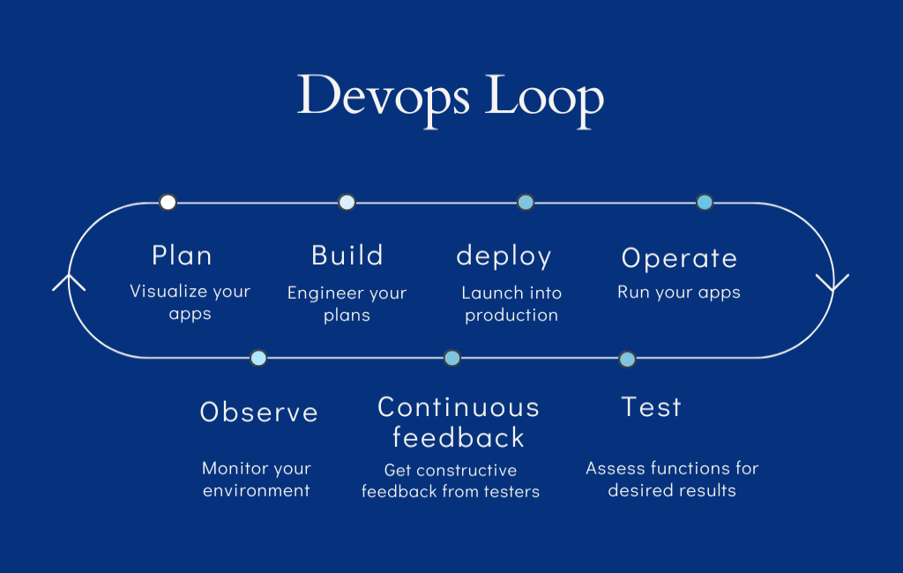
Manual of Project
Objective: Implement an automated CI/CD pipeline using Jenkins, Docker, and Ansible. Description: Develop a pipeline to automate the build, testing, and deployment of a sample application. Utilize Jenkins for continuous integration, Docker for containerization, and Ansible for configuration management. Implement automated testing and deployment to a cloud environment. Technologies to use: Docker, Kubernetes, Jenkins, Ansible, CI/CD, Cloud Deployment.

Slide 3
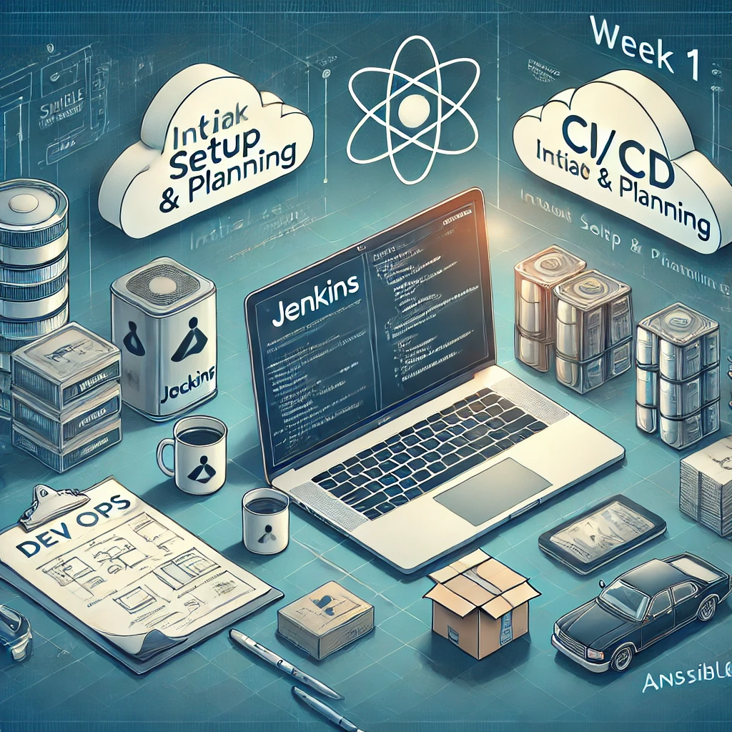
Week 1
Week 1: Initial Setup & Planning Tasks:
• Install Jenkins and Docker: Set up the Jenkins server and Docker on local or cloud environments.
• Create a basic Dockerized application: Develop a simple application (e.g., a web app) and Dockerize it.
• Set up Ansible: Install Ansible for configuration management.
• Pipeline Plan: Plan the structure of the CI/CD pipeline (build, test, deploy) and document tasks. Deliverables:
• Jenkins and Docker environments installed and configured.
• Dockerized application running locally.
• Basic Ansible setup.
• CI/CD pipeline plan documented.

Slide 4
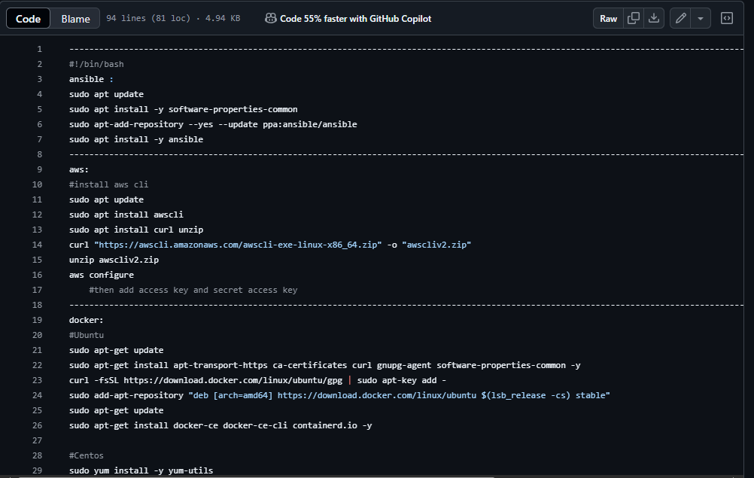

Slide 5
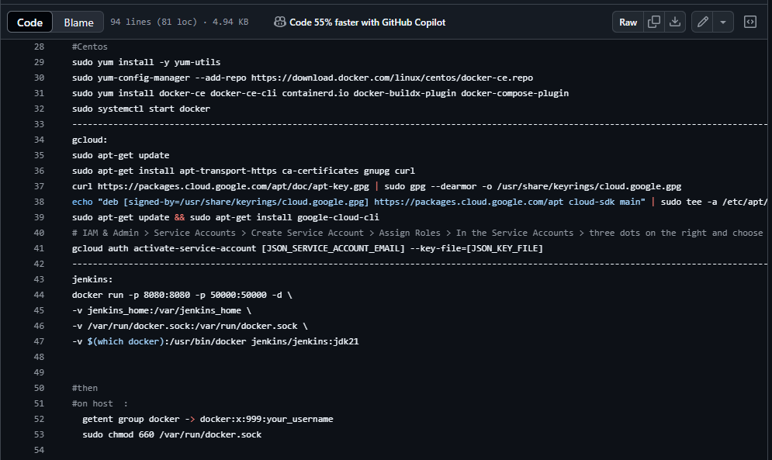

Slide 6
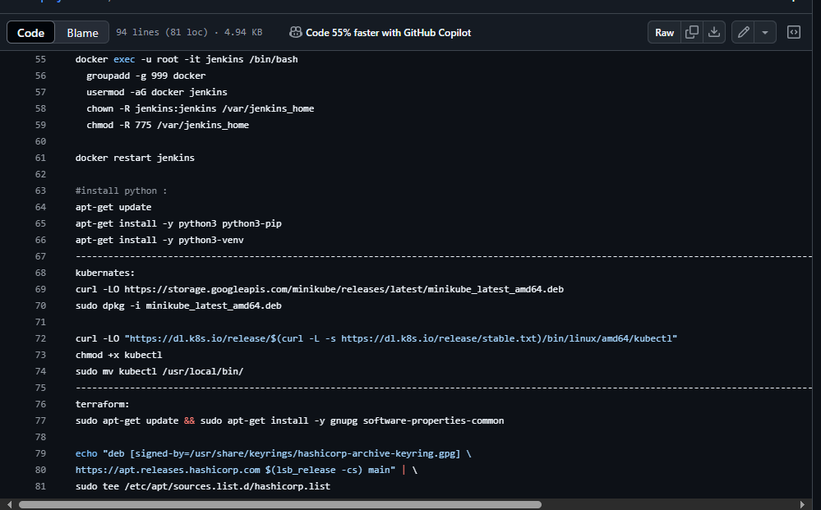

Slide 7
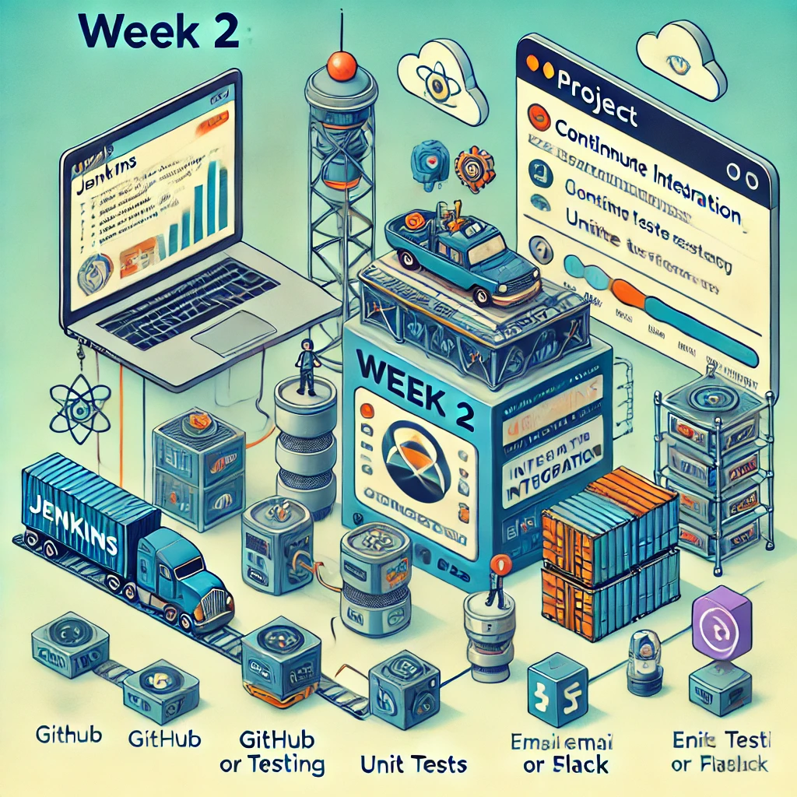
Week 2
Week 2: Jenkins & CI Integration Tasks: • Create Jenkins Jobs: Configure Jenkins to build the Dockerized application.
• Integrate Git: Set up GitHub or GitLab repository and integrate with Jenkins for continuous integration.
• Automated Testing: Add basic testing (e.g., unit tests) into the Jenkins pipeline for automated builds.
• Set Up Notifications: Configure email/Slack notifications for pipeline success or failure. Deliverables:
• Working Jenkins pipeline triggered by Git commits.
• Jenkins job that builds Docker images.
• Automated testing included in the pipeline. Notifications configured for pipeline updates.

Slide 8
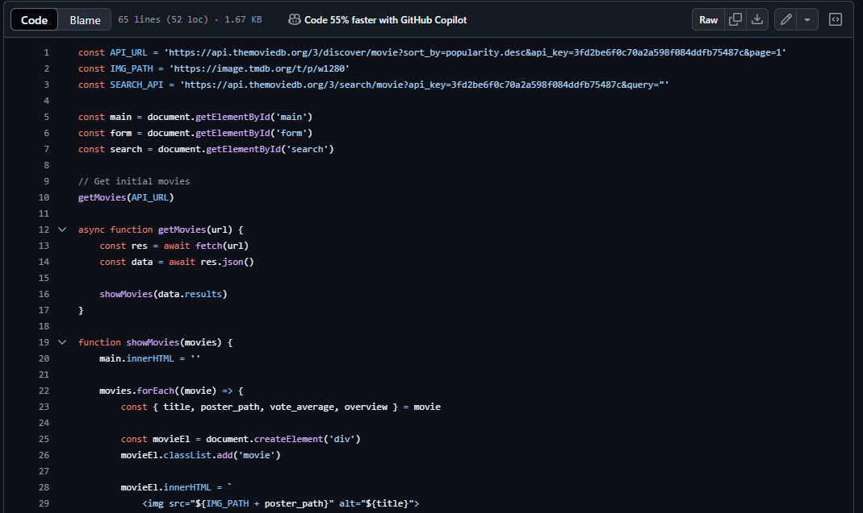

Slide 9
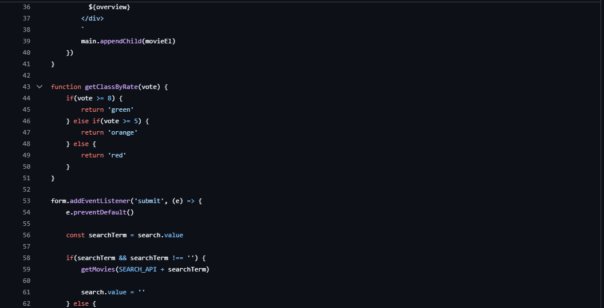

Slide 10
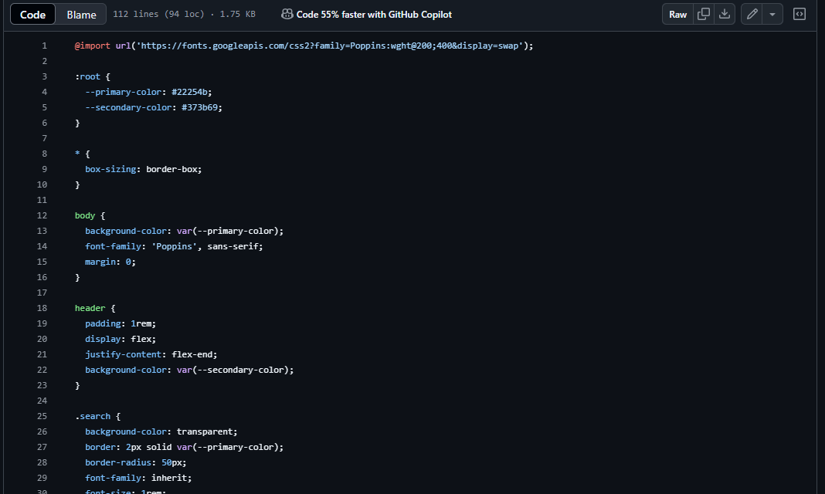

Slide 11
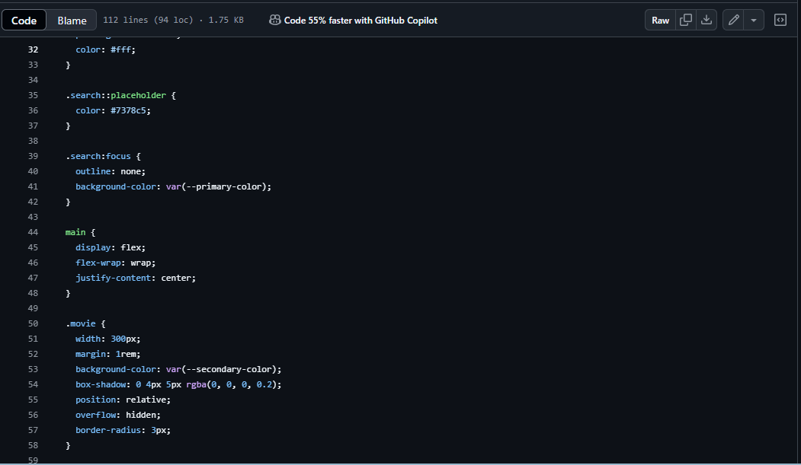

Slide 12
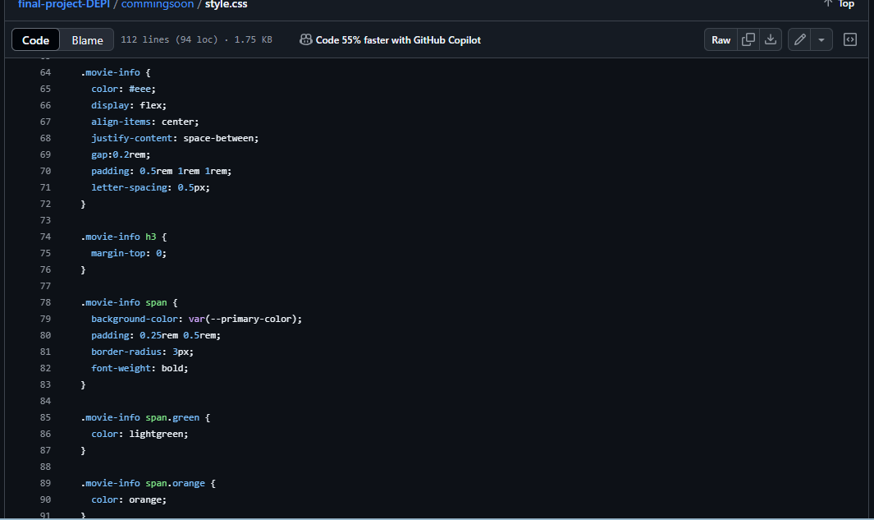

Slide 13
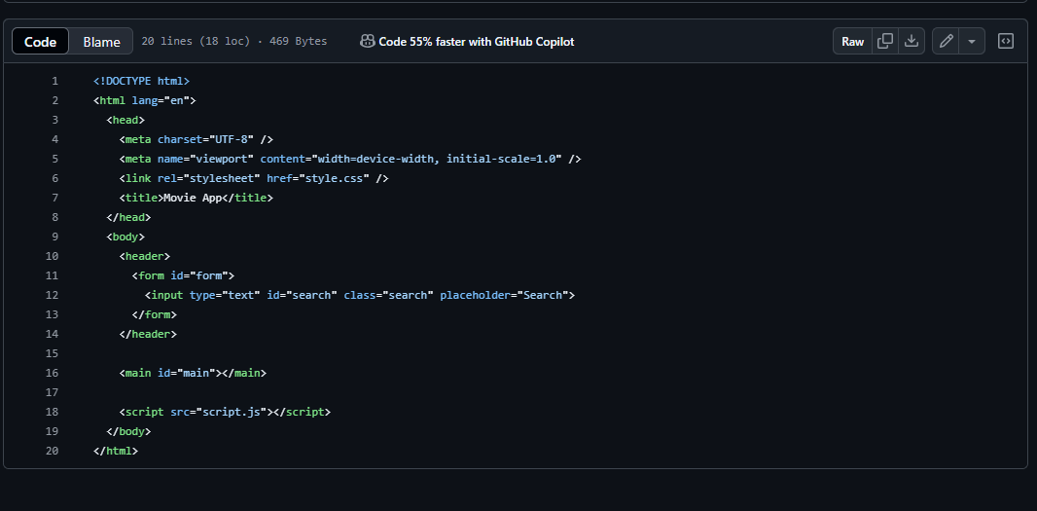

Slide 14
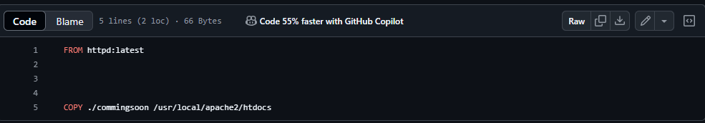

Slide 15
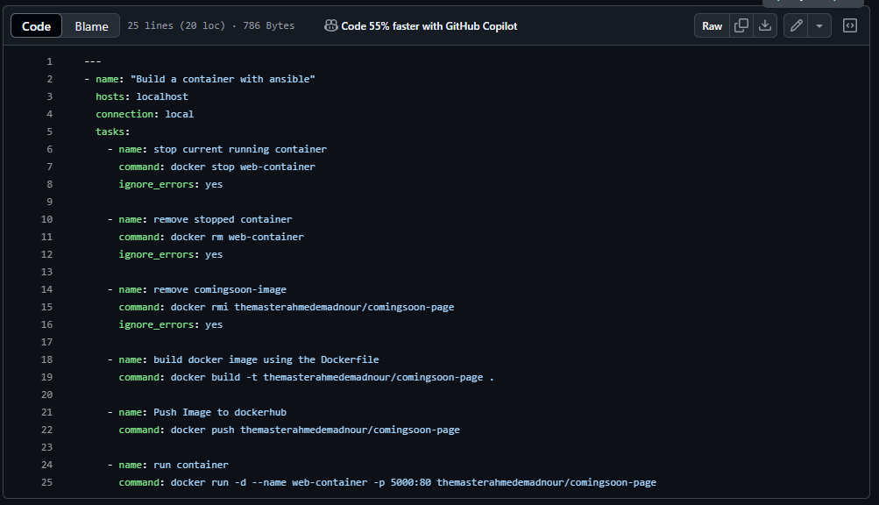

Slide 16
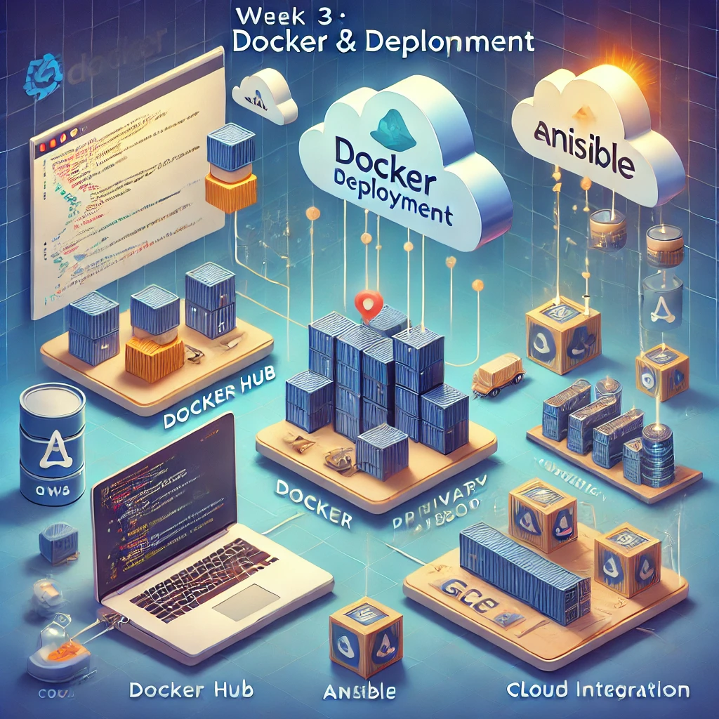
Week 3
Week 3: Docker & Deployment Tasks:
• Integrate Docker Hub or private registry: Push Docker images to Docker Hub or a private registry.
• Configure Ansible for Deployment: Write Ansible playbooks to automate application deployment to a cloud environment (e.g., AWS, GCP).
• Deployment Testing: Test deployment process with Docker and Ansible to ensure smooth automation. Deliverables:
• Docker images automatically pushed to Docker Hub or a registry.
• Ansible playbooks ready and tested.
• Successful deployment of the application to a cloud server.

Slide 17
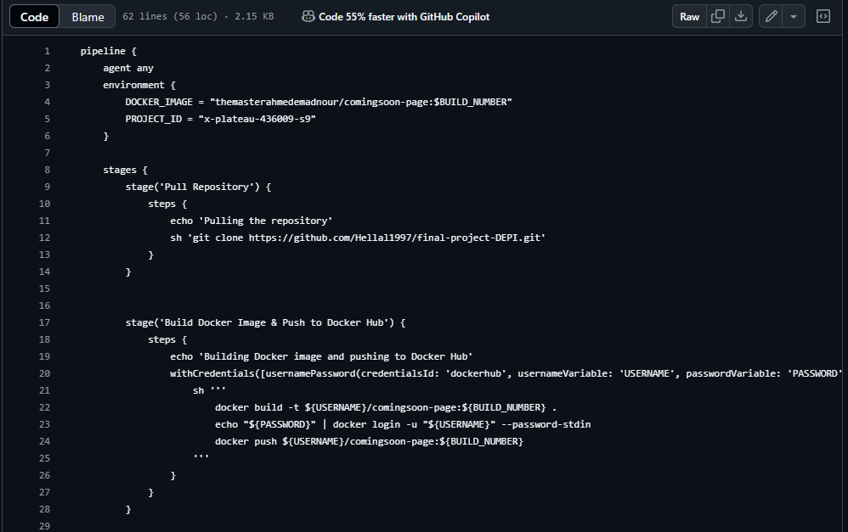

Slide 18
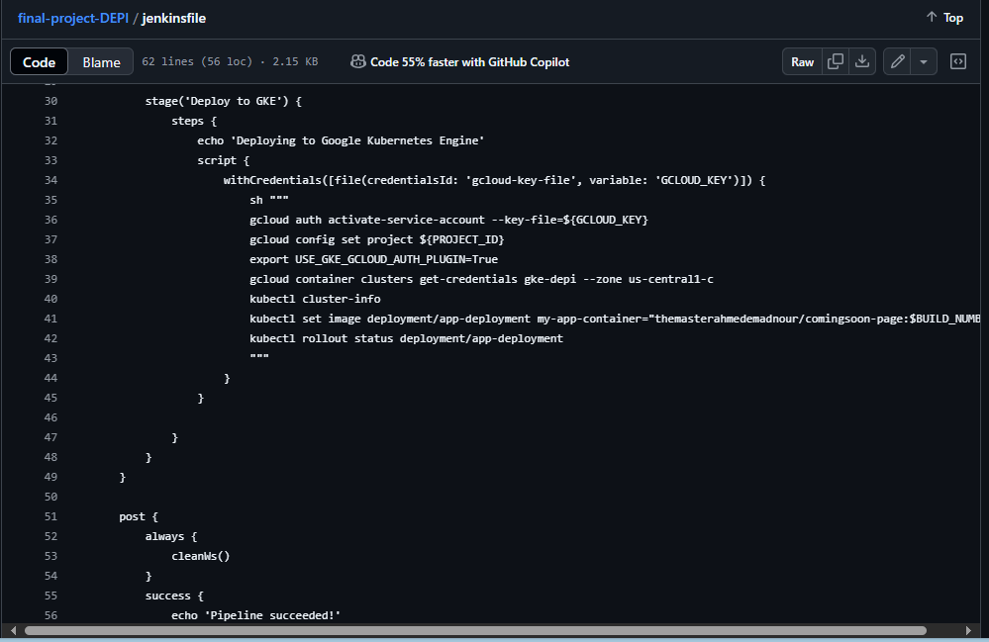

Slide 19
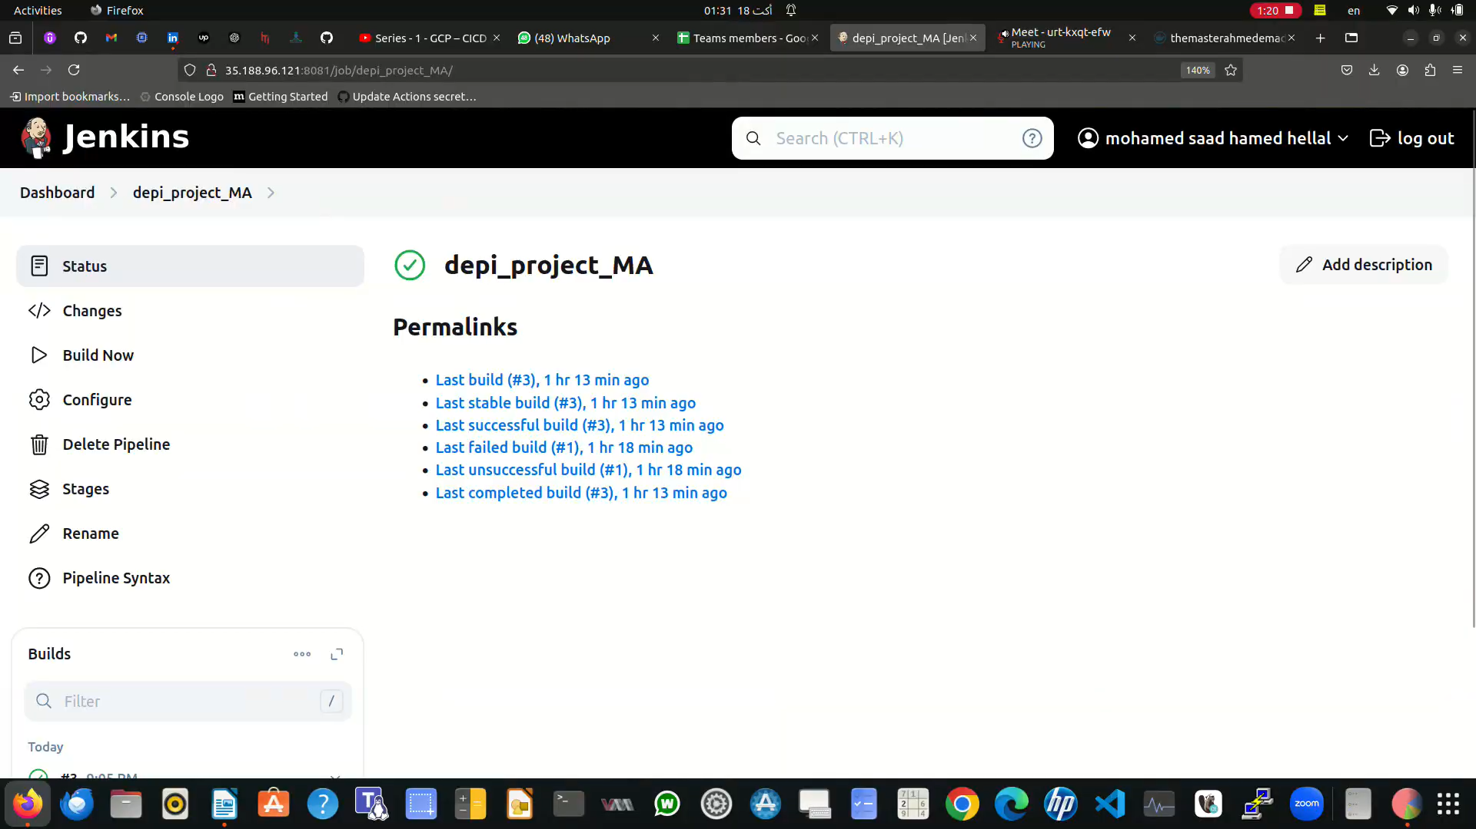

Slide 20
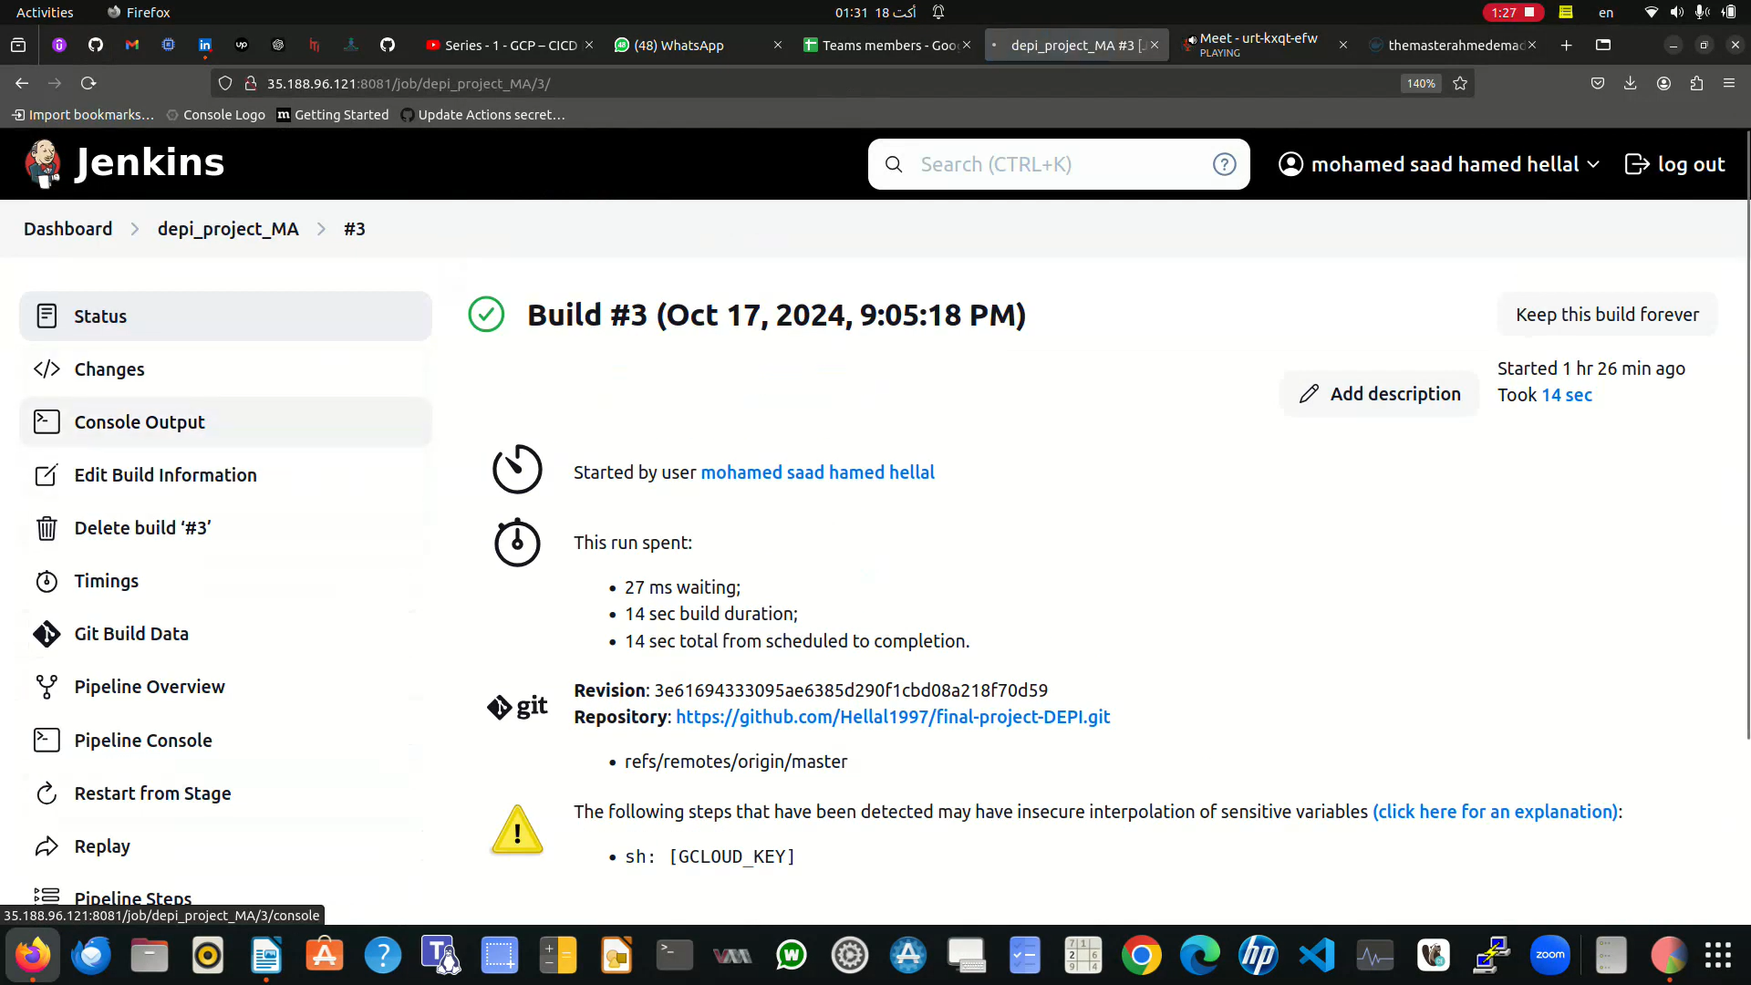

Slide 21
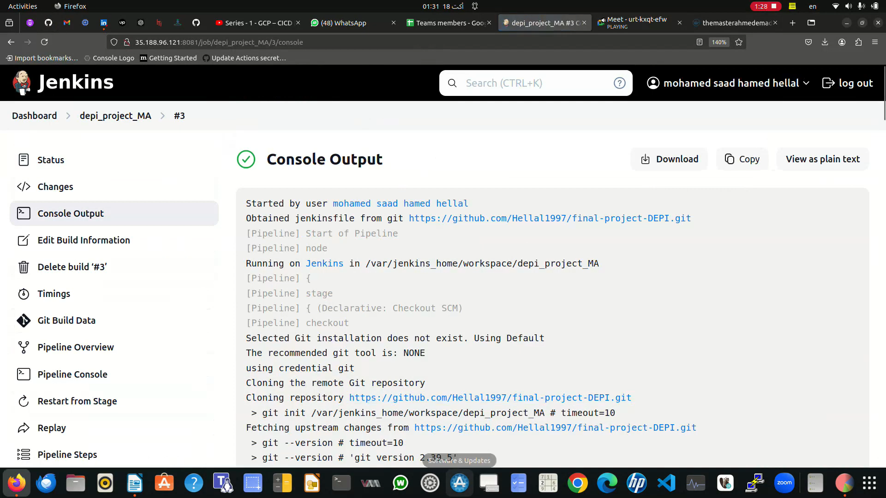

Slide 22
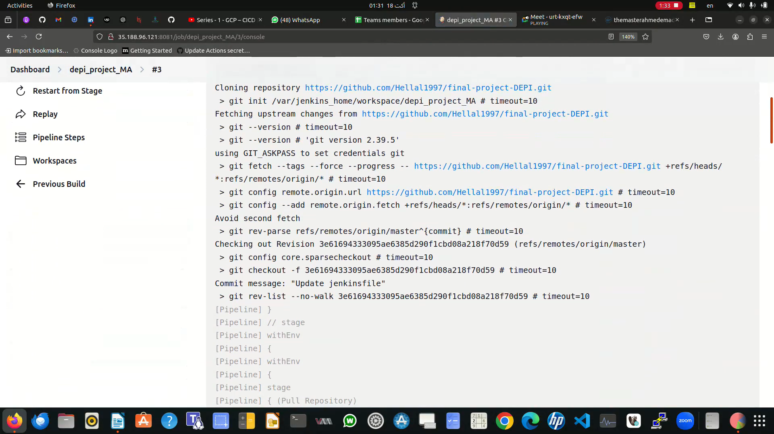

Slide 23
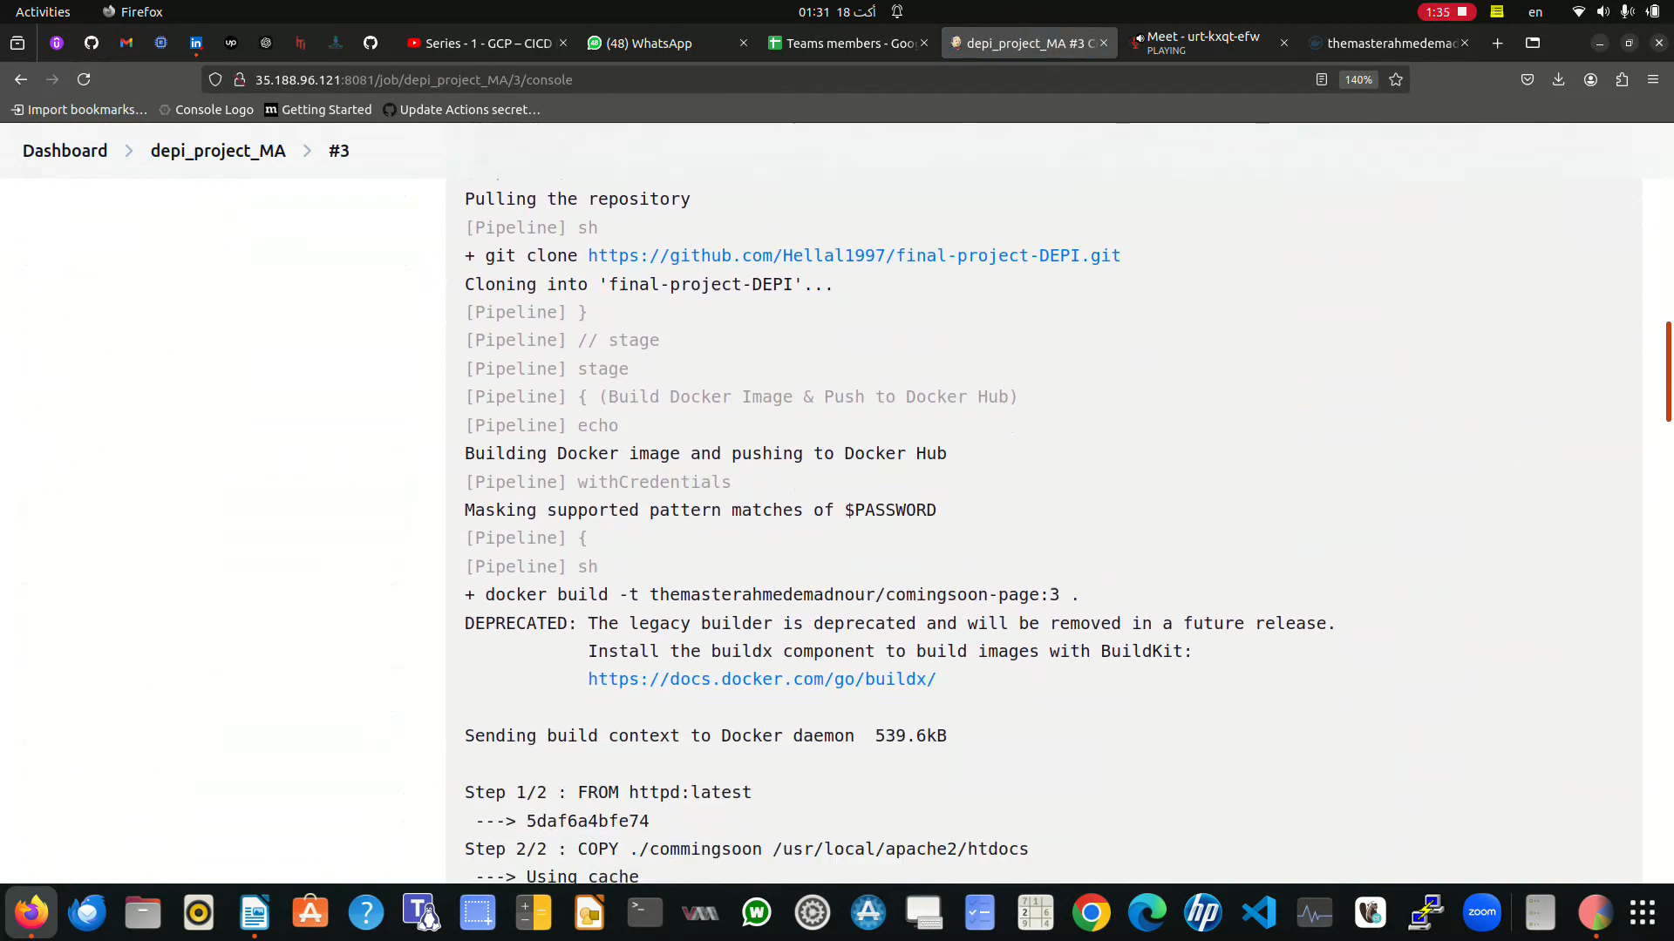

Slide 24
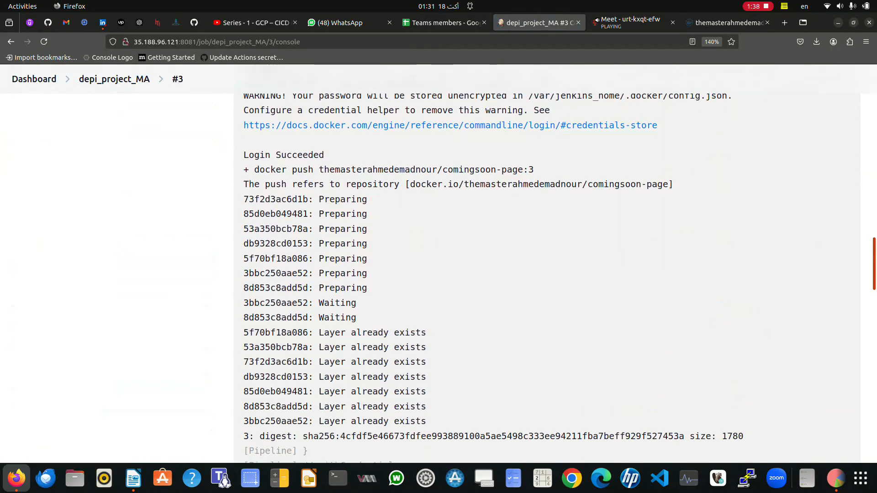

Slide 25
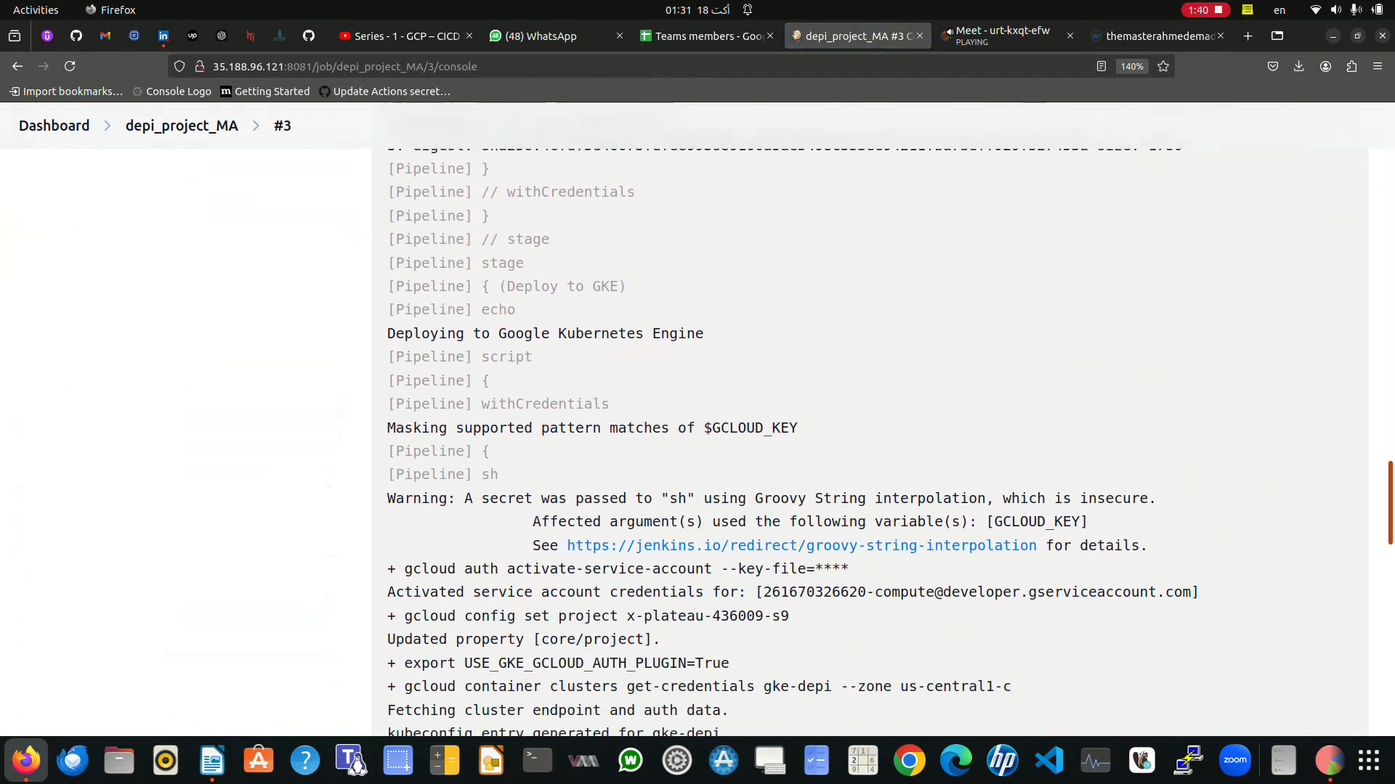

Slide 26
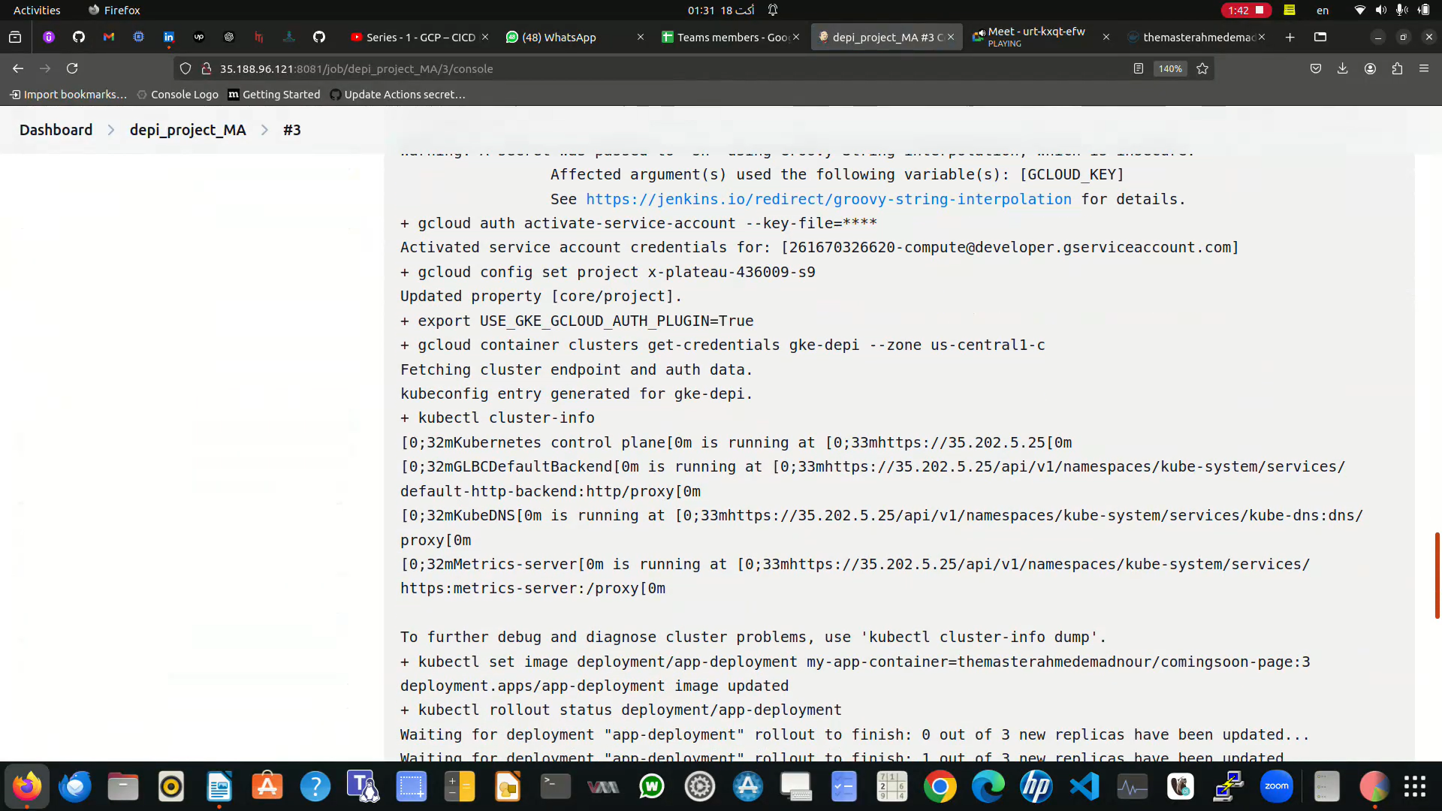

Slide 27
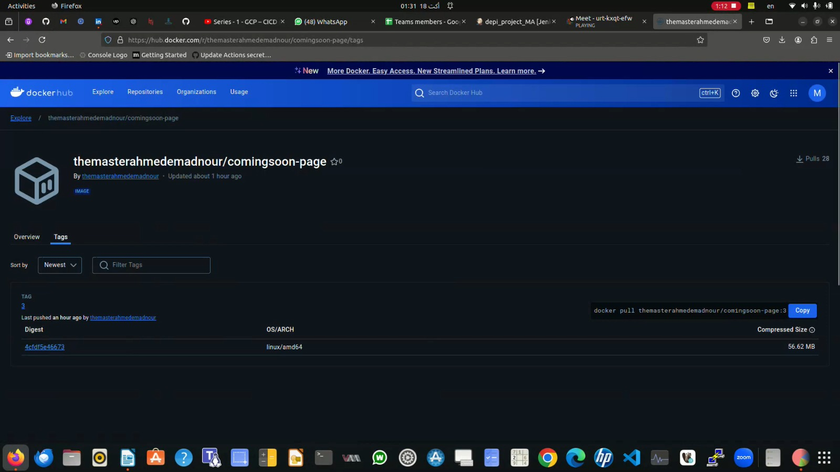

Slide 28
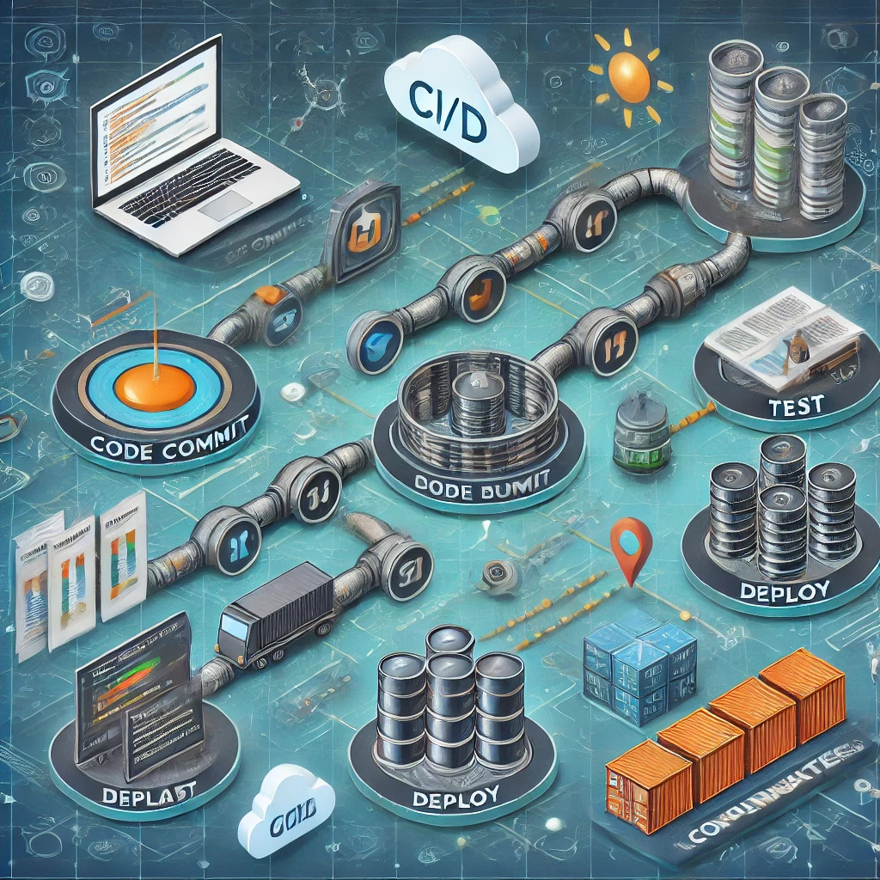
Week 4
CI/CD Refinement & Final Testing Tasks:
• Kubernetes Integration: Optional task configure Kubernetes to orchestrate the deployment of Docker containers if desired.
• Refine the Pipeline: Refine Jenkins jobs for efficiency (e.g., parallel stages, caching).
• Full Testing and Deployment: Conduct full tests of the CI/CD pipeline, from code commit to deployment.
• Documentation: Complete documentation of the project, including pipeline design, deployment process, and any issues faced. Deliverables:
• Kubernetes integration (if applicable).
• Fully refined CI/CD pipeline in Jenkins.
• Documented CI/CD pipeline process.
• Final deployment verified and tested on the cloud.

Slide 29
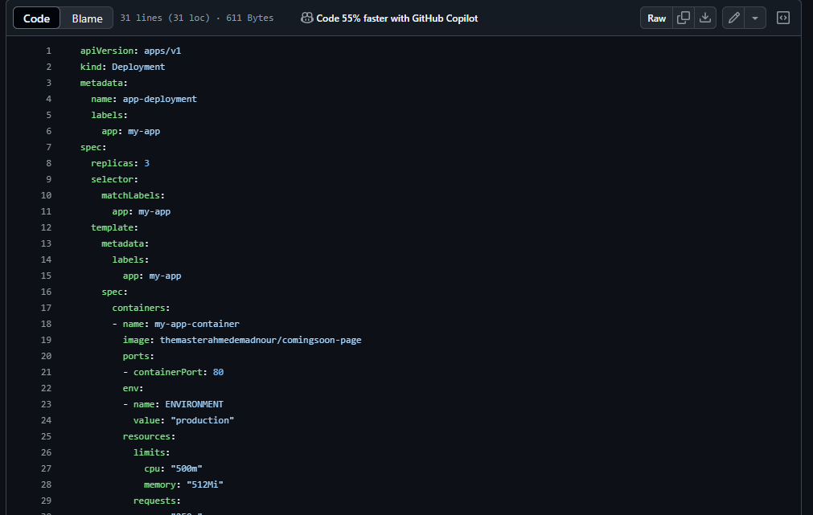

Slide 30
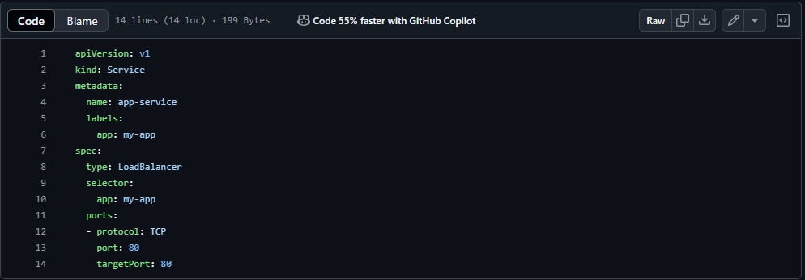

Slide 31
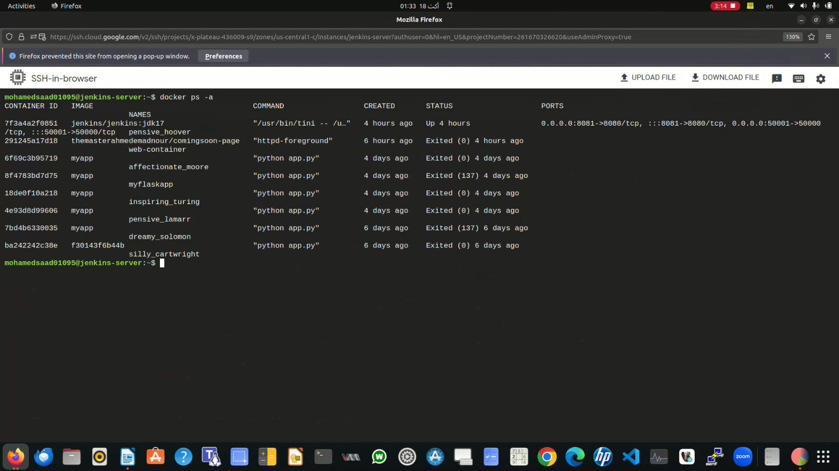

Slide 32
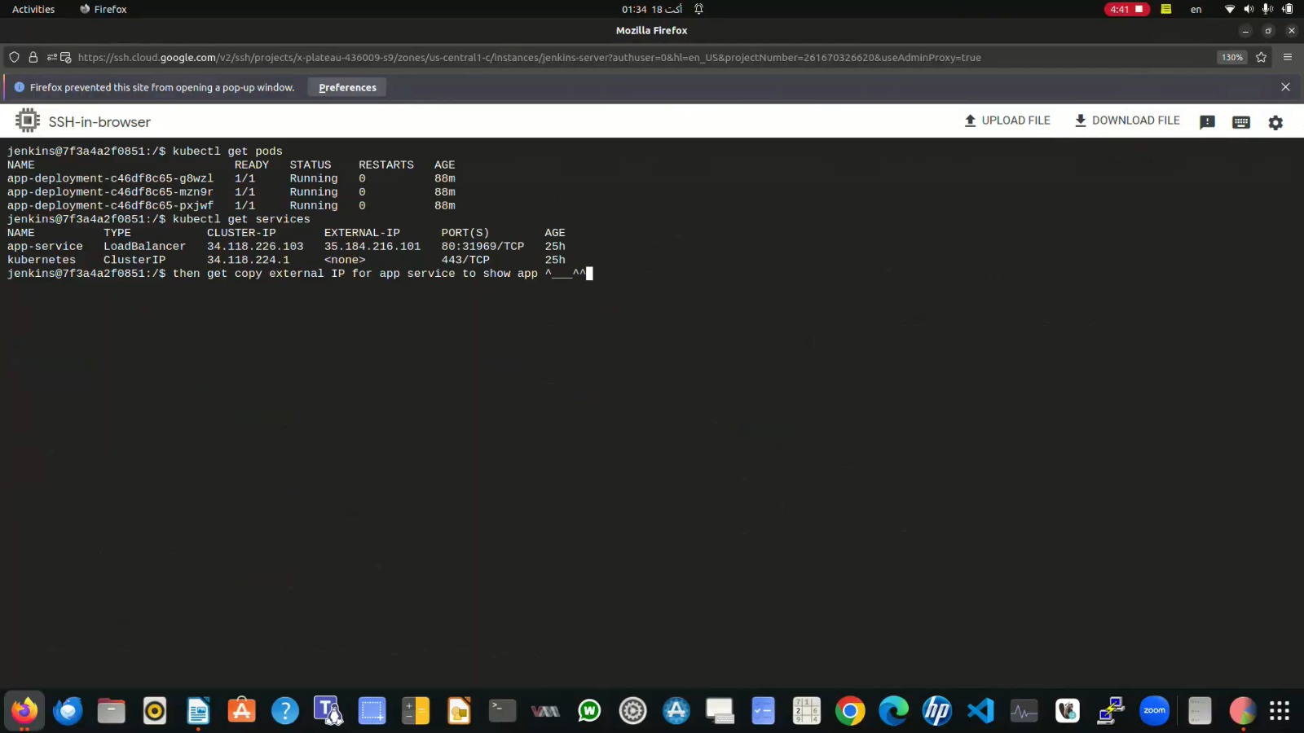

Slide 33
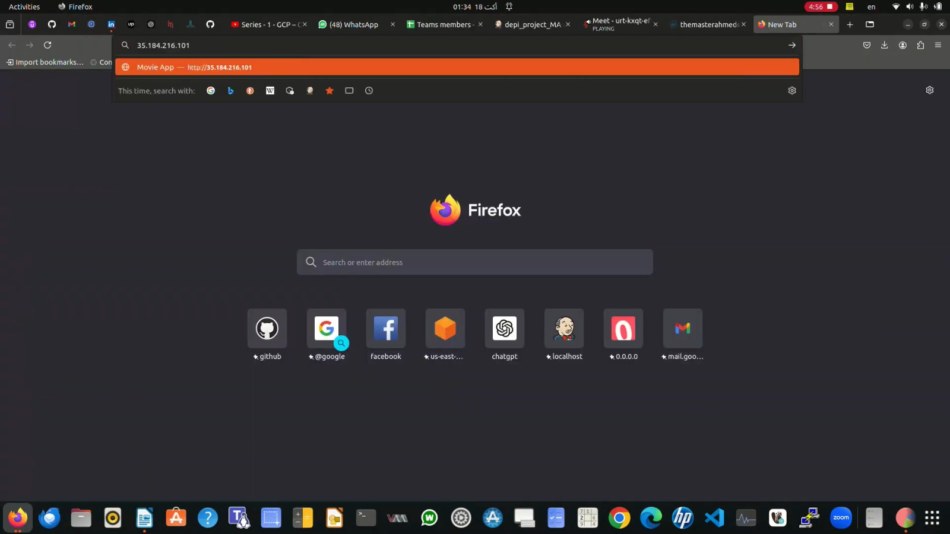

Slide 34
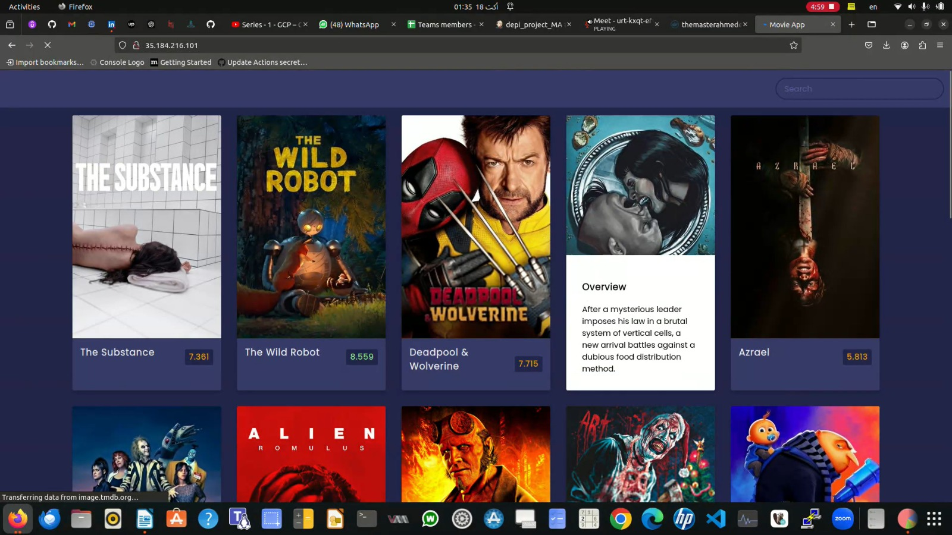

Slide 35
Thank You

